Slide 1


Final Year Project
Full stack NFT Marketplace
Supervised By: Mr. Tajamul Shahzad (Designation)

Slide 2
Project Team
Muhammad Afzaal Hameed (23733)
Usman Ayub (27952)
Mussab Saeed (27660)

Slide 3
Table of Content
Introduction and Background
Literature Review and Summary Table
Problem Statement
Methodology
Progress Report Summary
Requirements
Software System (Design + Implementation )
Endeavour (Team)
Next Steps
Prototype / Report

Slide 4
INTRODUCTION AND BACKGROUND

Slide 5





Introduction
The world of NFTs (Non-Fungible Tokens) has exploded in popularity, creating a demand for user-friendly platforms to trade these unique digital assets.
This guide explores the development of an NFT marketplace using a combination of powerful technologies:
Next.js for the front-end,
Solidity and Hardhat for smart contract development
Node.js for server-side functionality, and
MetaMask for user interaction with the blockchain.

Slide 6
Background
The rise of blockchain technology has led to the advent of NFTs, transforming the way we perceive and exchange digital assets.
NFTs provide a unique and verifiable way of owning and trading digital content, ranging from art and music to virtual real estate.
In response to the growing demand for a decentralized and user-friendly NFT marketplace, we have brought together a powerful combination of technologies to provide a feature-rich, secure, and intuitive platform.

Slide 7
Literature Review and Summary Table
OpenSea:
Primarily uses ERC-721: OpenSea predominantly supports the ERC-721 token standard, catering to non-fungible tokens (NFTs) representing unique digital assets.
Rarible:
ERC-721 for standard NFTs: Most NFTs on Rarible, like artwork and collectibles, utilize the ERC-721 standard for their unique and indivisible nature.
SuperRare:
Focuses on ERC-721: Similar to OpenSea, SuperRare primarily uses the ERC-721 token standard for representing unique digital art pieces on their platform.

Slide 8
Problem Statement
Despite its rapid growth, the NFT marketplace faces several hurdles impeding wider adoption. High and hidden gas fees, particularly on popular platforms which can get lessened that can discourage new users.
Finally, the need to educate the public about NFTs and their potential remains crucial for wider understanding and acceptance.
Addressing these challenges will be essential for the NFT marketplace to reach its full potential.

Slide 9
Methodology
Component-Driven Development (CDD): it is a methodology where software is built by creating, testing, and refining individual components before integrating them into a larger system.
Front-end design divided into separate components.
Each component is reusable.
Connecting components with smart contracts includes:
Buying NFTs
Selling NFTs
Reselling NFTs
Uploading

Slide 10
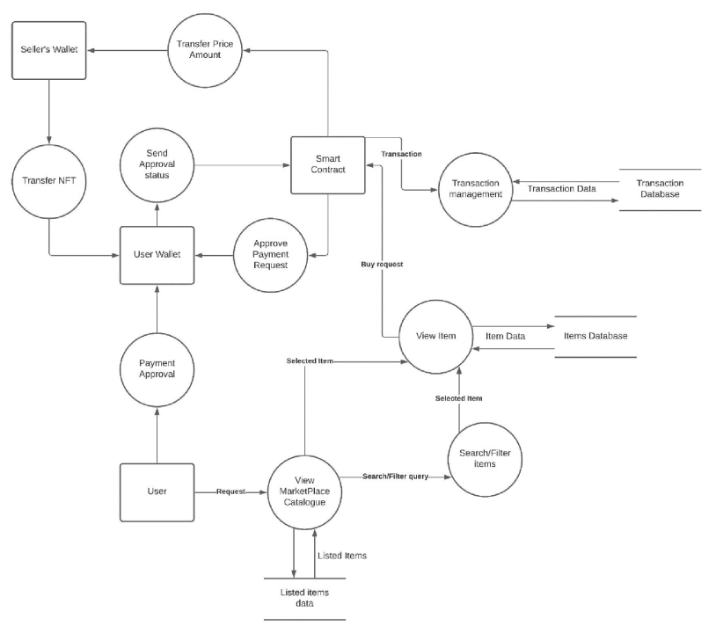

Slide 11
PROGRESS REPORT SUMMARY

Slide 12
Requirements
Our project has two users:
User
Admin
Use Cases : 16
Functional Requirements: 15

Slide 13
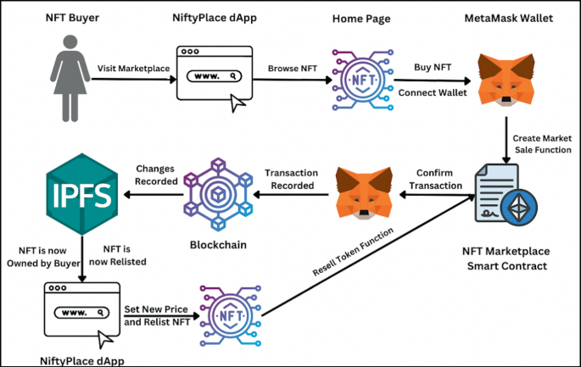
Design

Slide 14
Implementation
Development Tools & Technologies
IDEs and Tools
Backend: solidity, Javascript
Hardhat: Visual Studio Code
Technologies
Backend: Psolidity, Javascript
Framework: node js, next js
Network: Ethereum

Slide 15
Best Practices / Coding Standards
Best Practices
Version Control: GitHub
Continuous Integration and Deployment Practices
Coding Standards
CDD(Component-Driven Development )
TDD (Test-Driven Development)

Slide 16
ENDEAVOUR

Slide 17
Endeavour
Names | Roles
Muhammad Afzaal Hameed | Component redesign , Documentation
Usman Ayub | Layout design, component deployment, smart contracts building Documentation
Mussab saeed | Layout design, component deployment, smart contracts building Documentation

Slide 18
NEXT STEPS

Slide 19
Work Breakdown Structure (List of all Deliverables / Strikethrough Completed Deliverables)
Week 1 & 2
Project Idea
Week 3 & 4
Proposal Presentation
Week 5 & 6
Literature Review
Week 7 & 8
Finalized Technologies and Tools
Week 9 & 10
Front-End and Report Documentation
Week 11 to 14
Front-End Development
Week 15 and 16
Smart contracts

Slide 20
Challenges
Layout Design
Component breakdown
Reusability of components
Page rendering

Slide 21
PROTOTYPE & REPORT

Slide 22
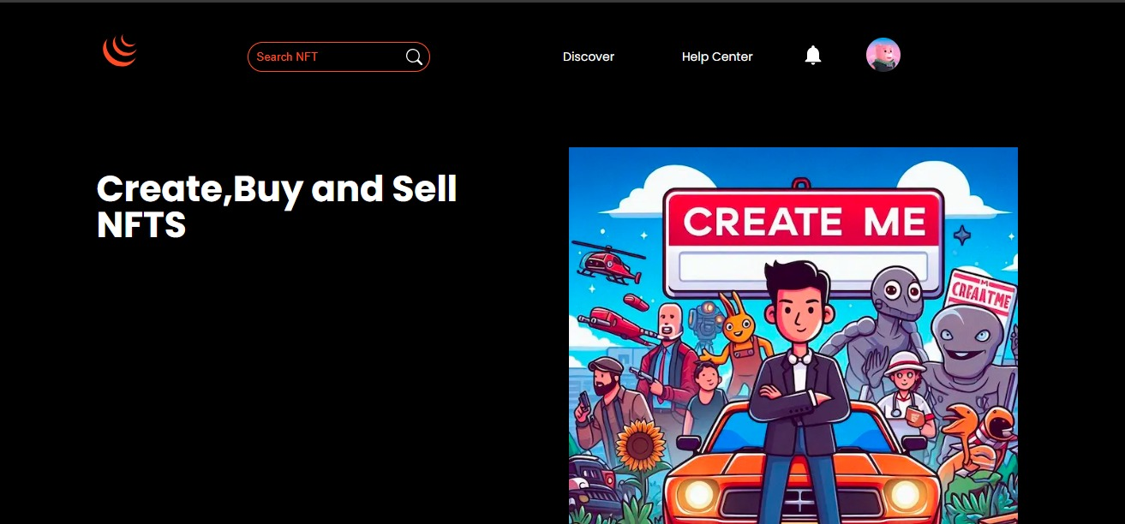
Prototype

Slide 23
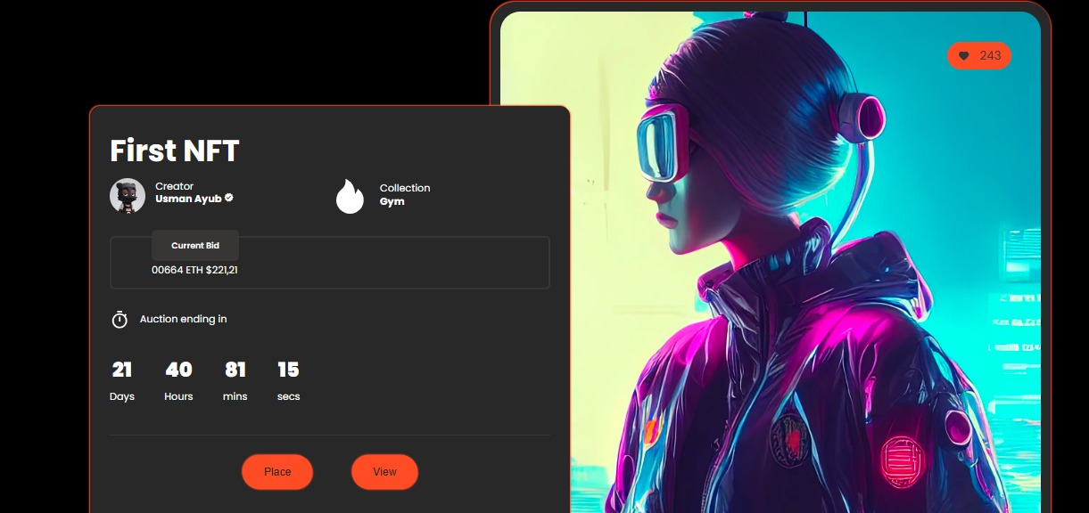
Prototype

Slide 24
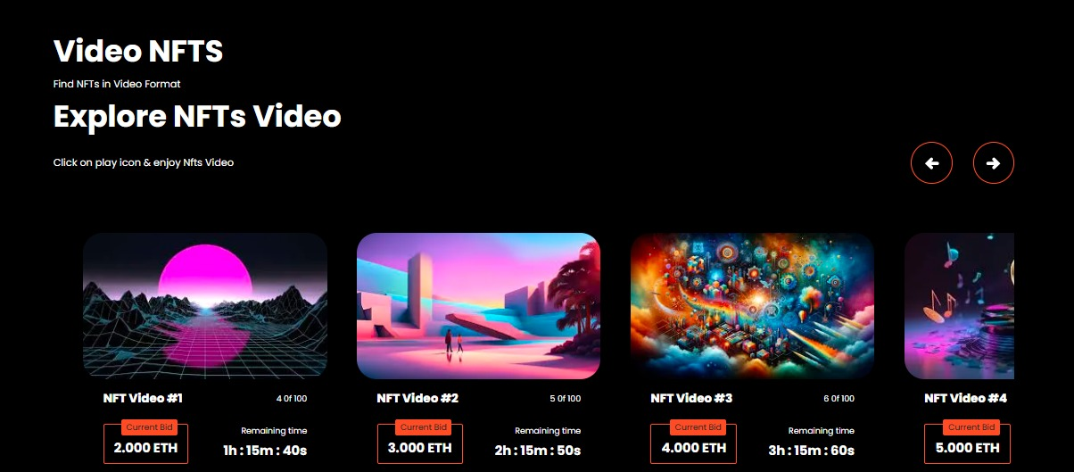
Prototype

Slide 25
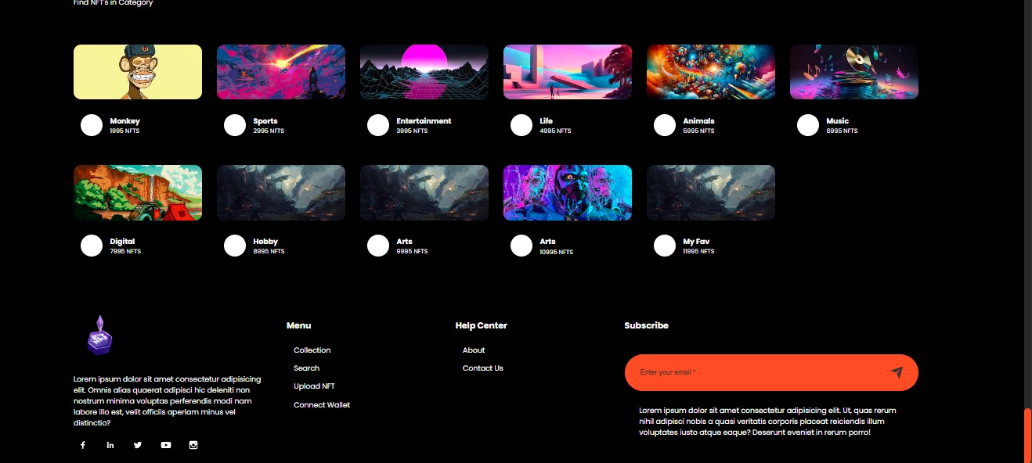
Prototype

Slide 26
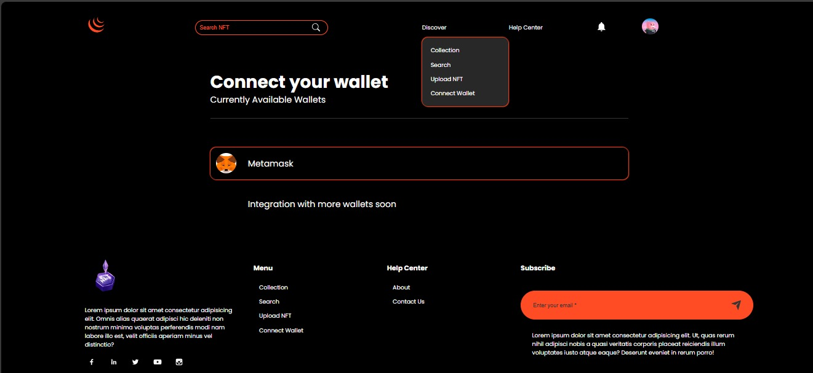
Prototype

Slide 27
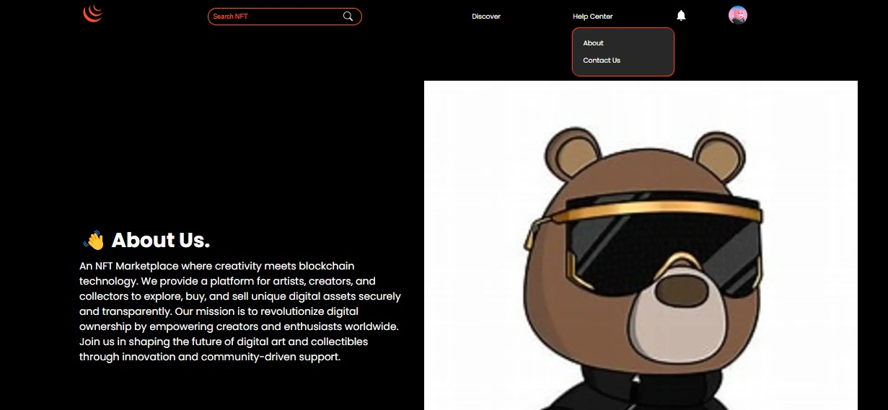
Prototype

Slide 28
Report
Chapter 1: Introduction
Chapter 2: Literature Review / Market Survey
Chapter 3: Requirements and Design
Chapter 4: Implementation and Test Cases
Chapter 5: Experiment Results and Analysis
Chapter 6: Conclusion & Future Direction

